Slide 1
Data Science Capstone Project – The Battle of Neighborhoods
Finding optimal locations for new hotels in Toronto
Using Data analysis and machine learning
By Nadav Lavy

Slide 2
Introduction
Finding a good location for a new hotel requires considering many variables
For a hotel to be attractive it should be in the center of things
Where there are many day and night attractions, and facilities
But what about other existing hotels ? Are they just competition ?
Or do they show us there is high demand in these areas ?

Slide 3
Data
In order to find the best locations for hotels in Toronto we need :
Geospatial Data regarding Toronto –
A list of postal codes was scraped from Wikipedia,
from this list I extracted all of the neighborhoods in Toronto
and added their coordinates from a .csv file
Data regarding food and art & entertainment venues,
nightlife spots and hotels, in Toronto – this was acquired using
Foursquare API

Slide 4
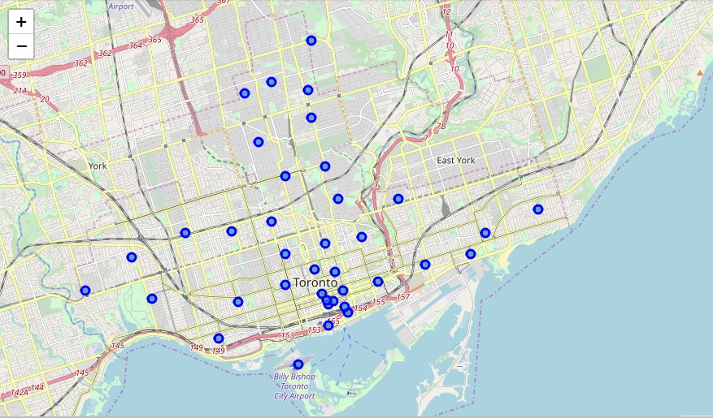

Slide 5
Methodology
I explored Venues in the different neighborhoods using foursquare API
By types :
Food venues
Arts & entertainment venues
Nightlife spots
Hotels
And summed the results by neighborhoods

Slide 6

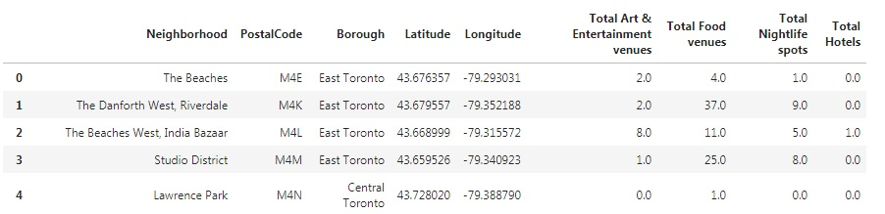
Here a the first five rows from the table:

Slide 7
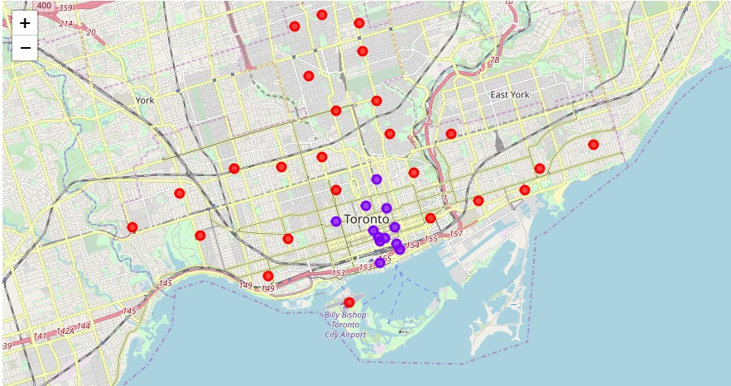
Then using K-Means we clustered the neighborhoods :

Slide 8
Characterizing the clusters
We explored the clusters and found out that :
cluster 0 - neighborhoods with few to none art & entertainment venues, nightlife spots or hotels (food venues were basically everywhere)
cluster 1 - neighborhoods with high numbers of venues from all above types
from this we can deduce that cluster 0 is more residential or industrial neighborhoods and cluster 1 is more of centers of attractions

Slide 9
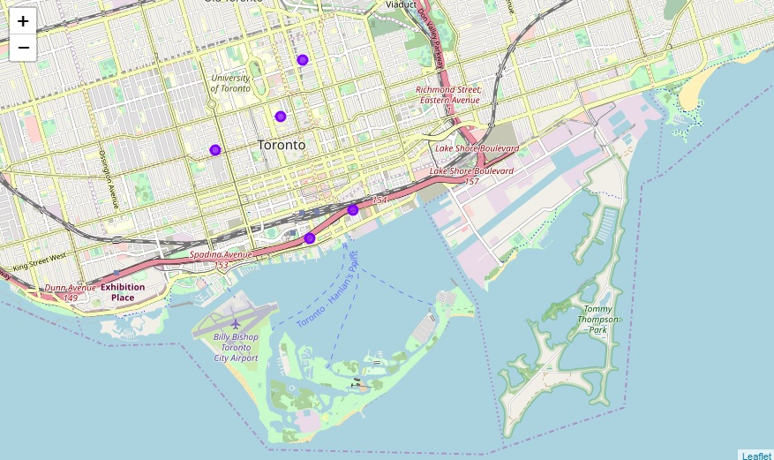
We removed all neighborhoods containing more then 10 hotels :

Slide 10
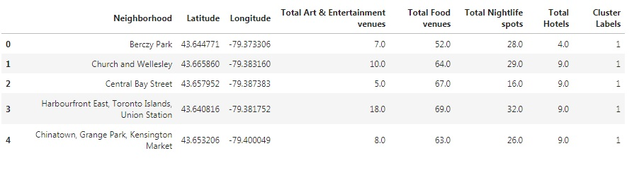
Results

Slide 11
Discussion:
South central Toronto (Downtown) is the Central area with venues to support the presence of a hotel
There are no other areas in Toronto that fit our criteria
We found five areas recommended for a new hotel

Slide 12
Recommendations
All five areas displayed above were found optimal in the aspects considered
Additional aspects such as crime rate, traffic, housing prices, etc. should also be considered (based on market research, or stake holders insights) to get a more accurate result
When exploring the results, 2 areas stand out :
- Berczy Park :
having the lowest number of hotels (4, while the rest have 9)
- Harbourfront East, Toronto Islands, Union Station :
having the highest number of all other venues

Slide 13
Conclusion
Using data from the web and foursquare API we were able to define
downtown Toronto as the central area for Tourists and activities
In this area we identified 5 neighborhoods who lack hotels and are open for competition by a new hotel
We then managed to identify 2 neighborhoods that stand out and require additional research

Slide 14
Thank you for the attention !

